Slide 1
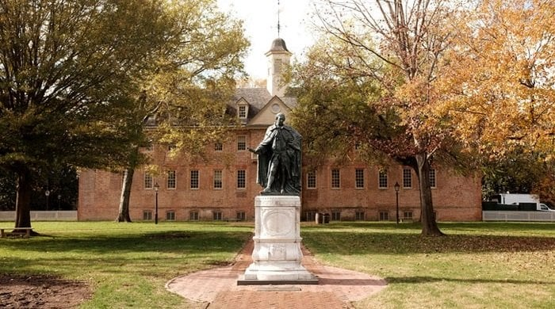
Campus Security Act:
Don’t drive away smart students
American Foreign Policy
Presented by: Shen Wenying
Notes:
Photo by Austin Distel on Unsplash

Slide 2
OUTLINE
Introduction of Campus Security Act
Who am I representing?
Chinese students’ Contribution on and outside of campus
The scope of STEM degree
Supporters VS Opponents
Strategy and Discussion

Slide 3
Timeline of Acts
May 29, 2020
signed up
April 22, 2021
introduced
June 8, 2021 passed Senate
July 29, 2021
introduced
Nov, 2022
introduced
Proclamation 10043
Secure Campus Act of 2021
The America COMPETES Act of 2022
Countering Communist China Act
Protecting Higher Education from the CCP Act of 2022
Prohibit students in the PRC associated with the People's Liberation Army from obtaining F visas or J visas;
As was reported by Reuters in Sep 2020, visas of more than 1,000 Chinese students had been canceled.
Deny the citizen of the PRC:
Enter to the U.S. to participate in graduate-level or post-graduate-level coursework or academic research in a field of STEM at an institution of higher education;
Receive a Federal research and grant.
﻿Prohibit all personnel of each Federal science agency ﻿from participating in a foreign government talent recruitment program (TRP);
﻿Prohibit awards from being made for any proposal in which any individual ﻿is participating in a foreign government TRP.
﻿Sensitive research project list.
Foreign student participation in sensitive research projects.﻿
Prohibiting lobbying contacts by former Members of Congress on behalf of communist countries.
﻿No institution of higher education shall be eligible to receive funds or any other form of financial assistance under any Federal program for an award year in which the institution employs an CCP-funded instructor.

Slide 4
Purpose: Stop CCP from stealing technology
01
It seems that the scope of STEM degree is clear-cut. Therefore, it is easy to exclude the thieves.
Assume: all the Chinese students who pursue STEM degrees are controlled by the CCP
FLAWS
02
04
The act ensure fair competition of ideas, protect American intellectual property and innovation.
The act align with national interest of the United States when the U.S. and China compete in cutting-edge technologies.
03

Slide 5
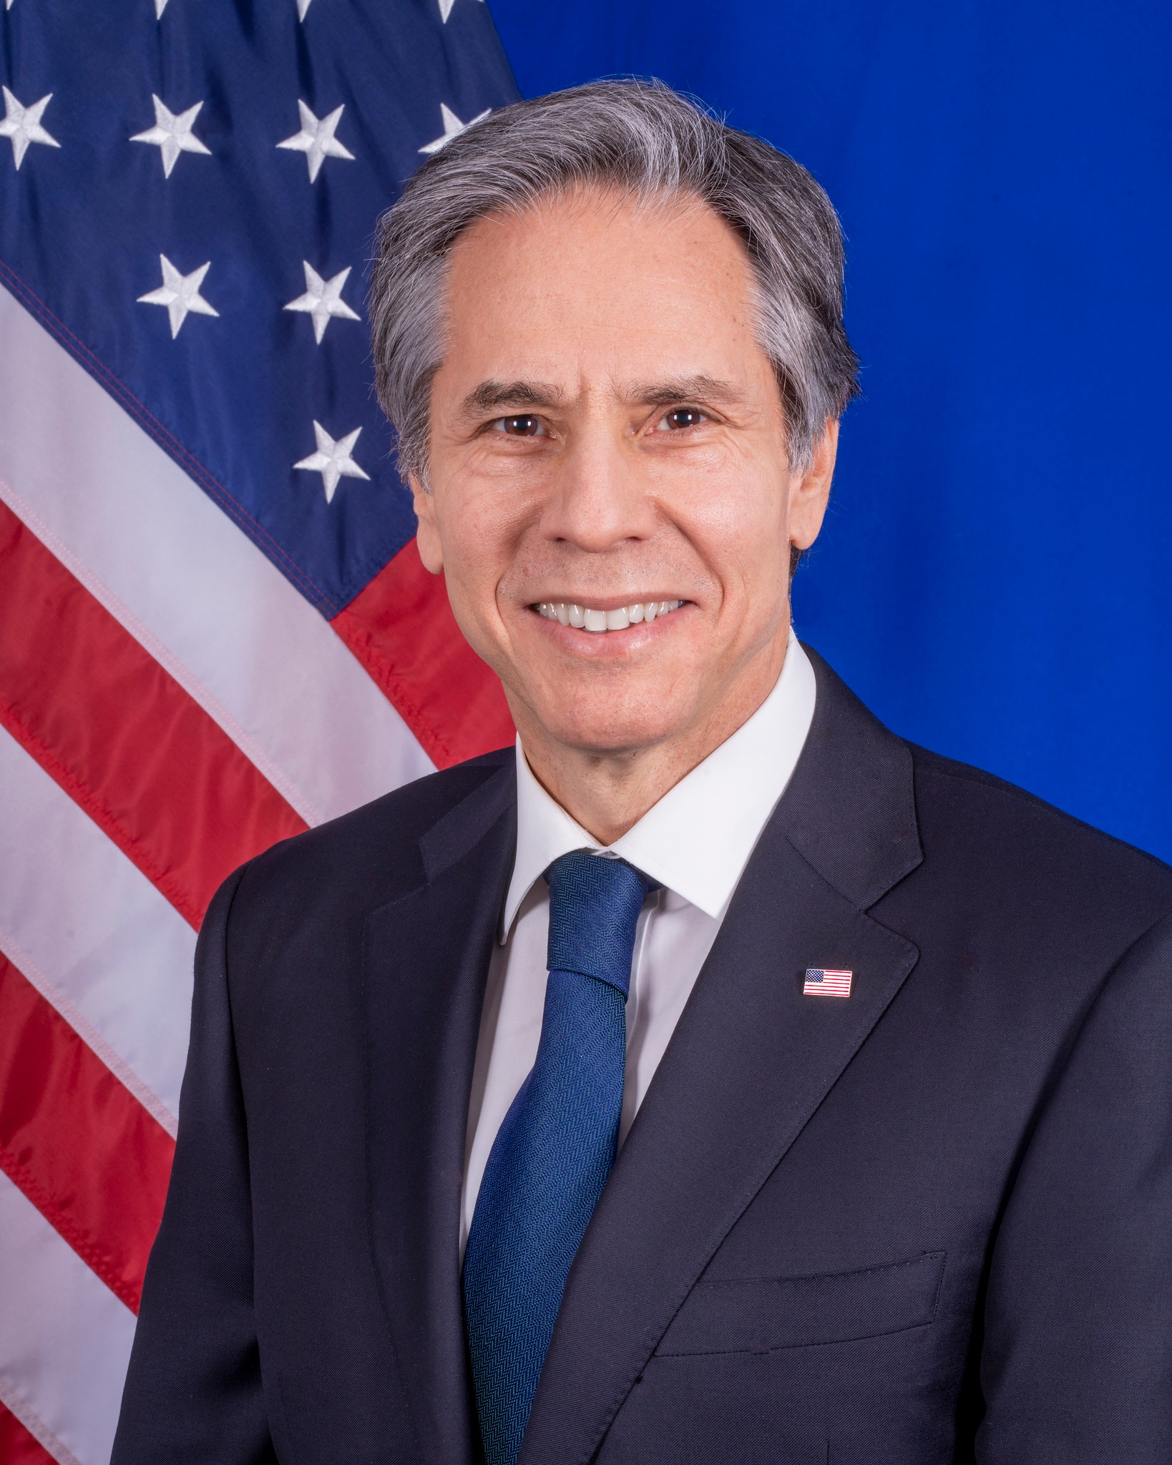
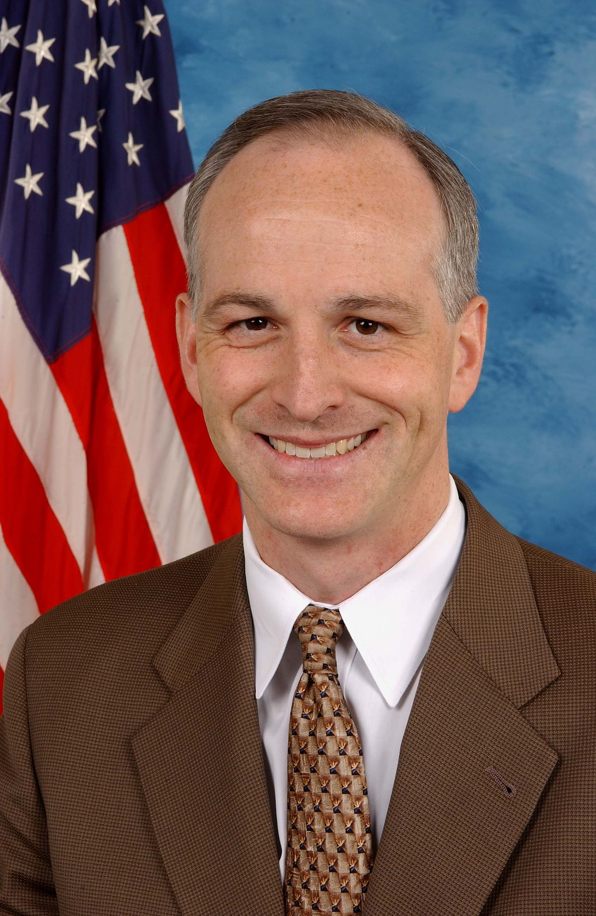
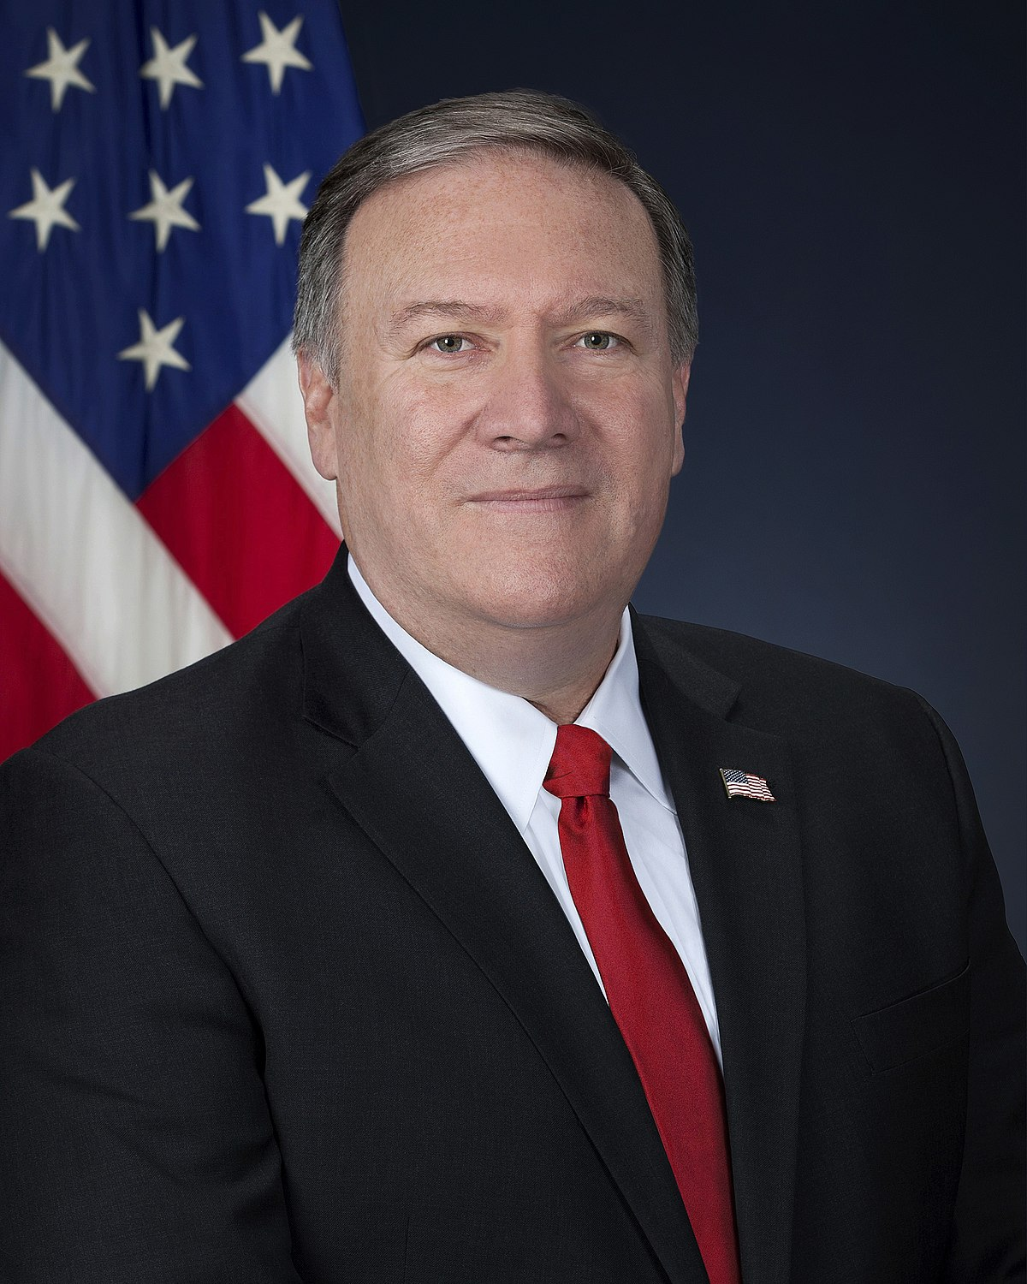
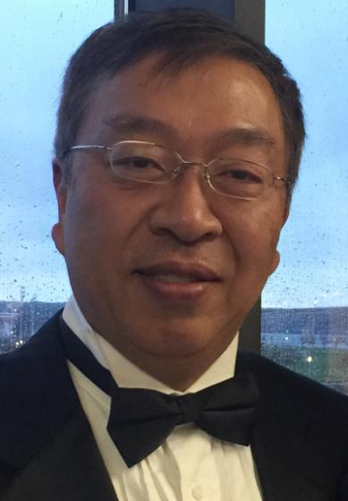
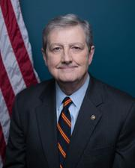
Who am I representing? China, CCP, or Chinese people?
Antony Blinken
Secretary of State
China’s transformation is due to the talent, the ingenuity, the hard work of the Chinese people.
Adam Smith
Representative
The Select Committee on the Strategic Competition btw US and CCP should not be used as a platform for hateful or violent xenophobia or racism.
Mike Pompeo
Some of Beijing's most frequent victims are Chinese students themselves who came here to experience academic freedom. They didn't expect to be followed.
Miles Yu
Hudson Institute
The CCP doesn't represent the Chinese people. When the Chinese people succeed, the Communist Party feels threatened.
John Kennedy
Senator
Chinese people are wonderful people but they are brainwashed!
D
D
R
R
R
Chinese people and those of Chinese heritage are separate from the CCP and the PRC state. By incorrectly using these terms interchangeably, we will form and reinforce biases that all Chinese people are closely associated with the CCP and PRC. Lobbying purpose: Make Chinese students represent themselves and keep campus safe and prosperous!
Notes:
https://www.freepik.com/free-photo/happy-business-woman-pointing-copyspace_7379048.htm
https://www.freepik.com/free-photo/happy-young-man-using-laptop-computer_8195606.htm
https://www.freepik.com/free-photo/smiling-confident-businesswoman-posing-with-arms-folded_5546285.htm
https://www.freepik.com/free-photo/portrait-handsome-businessman-with-glasses_12232405.htm
https://www.freepik.com/free-photo/confident-stylish-handsome-young-businessman-adjusting-necktie-looking-camera_2788501.htm#page=1&query=business%20man&position=45&from_view=search

Slide 6
Asian American Scholar Forum (AASF)
A nonprofit organization promoting academic belonging, openness, freedom, and equality for all.
Mission
Push back on China Initiative
Successfully advocated with the Biden administration for the end of the Justice Department’s “China Initiative” and on individual cases impacting scientists.
Prevent a harmful amendment
Prevented the inclusion of a harmful amendment in the CHIPS PLUS legislation and in the National Defense Authorization Act & led recommendations to the White House on disclosure requirements within the Asian American and civil rights advocacy community
Research
Caught in the Crossfire: Fears of Chinese-American Scientists (showing a growing number of Chinese-descent scientists have left or are leaving the U.S. and avoiding federal grant application, due to fears and an unwelcoming environment in the U.S)
Legal Education
Co-hosted webinars to educate the community of topics ranging from individual civil rights to the implications of federal policies; Established partnership with NYU Law’s US-Asia Institute to further legal research on how and why scholars are being targeted.

Slide 7



Chinese students’
Contribution on campus
01
02
03
Around 89% of all Chinese students abroad are self-funded. ﻿The majority of Chinese students and scholars who come to the U.S. engage in legitimate academic activities and are part of the cultural exchange.
In 2020, 380,000 Chinese students studied in the U.S., comprising approximately 34% of all international students enrolled. These individuals contributed $15 billion to the economy through tuition fees and other expenses during 2018/19 academic year alone.
7% of all 2020 US doctoral degrees in Science & Engineering (S/E) went to foreign students from China. ﻿or those from China, serving as TA & RA and assisting with academic activities.
03

Slide 8
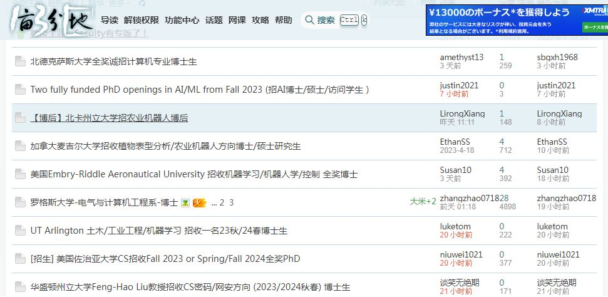
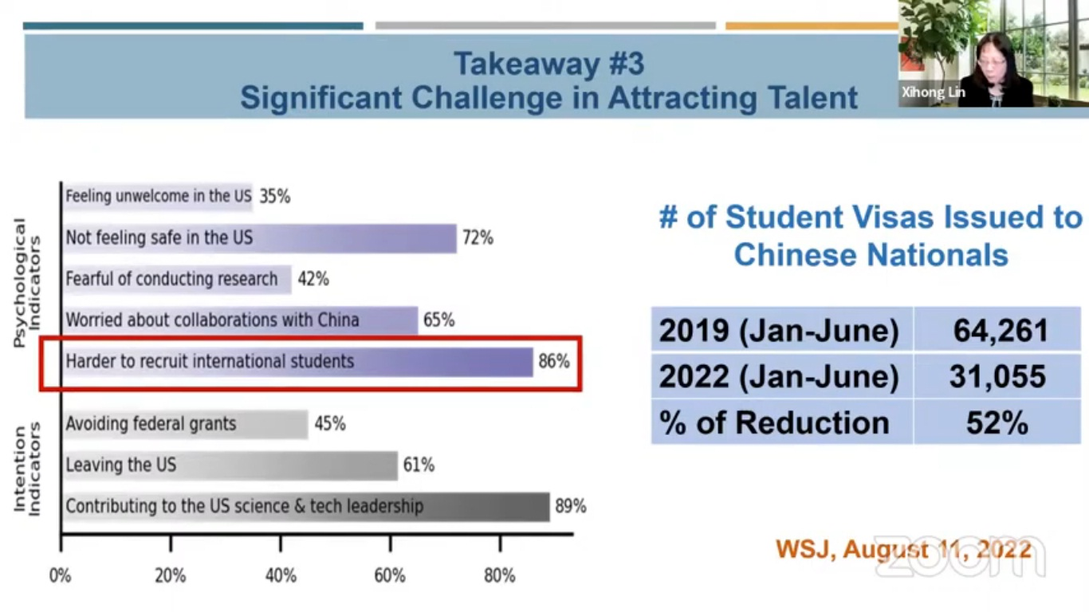
Many Chinese professors are posting application advertisements on a Chinese studying abroad forum (1point3acres.com/bbs) which is sponsored by citizens rather than gov.

Slide 9
Chinese STEM PhD graduates stay long after graduation’ → don’t drive them away
Oh we’ve seen this happen already. Qian Xuesen, a founder of the Jet Propulsion Lab, was persecuted in the USA and detained for 5 years. He went home to China and 12 years later, China had its first Hydrogen bomb.
01
02
03
Chinese and Indian students make up nearly half, and “most stay long after graduation. In February 2017, approximately 90% of Chinese nationals and 87% of Indian nationals who completed STEM PhD programs in the US between 2000 and 2015 were still living in the country.
Those who stay in the country after receiving their degrees strengthen the domestic STEM workforce and make valuable contributions to the economy and society.
The USA had a secret weapon and brain drains from other countries. If you prevent Chinese from studying STEM in the USA, then they’ll simply go elsewhere, like Europe or Australia.
03

Slide 10
The scope of STEM VS China Scholarship Council
Traditional STEM,
Data analysis in Business School, etc.
In many Business schools, 22% of admission officers say their business programs are currently designated as STEM programs. Meanwhile, 23% say that they plan to go through the curriculum overhaul, making the program STEM-designated.
Admit trustworthy students case by case
Testify that you are not financially supported by government-run scholarship;
Declare that you respect freedom of speech and human rights. (if violated, the U.S. will send you back)
Add American constitution and history as required courses in any graduate curriculum. (China already set Mao’s ideology and Marxism as compulsory courses for foreign students)
China Scholarship Council, PLA, and Chinese defense firms

Slide 11
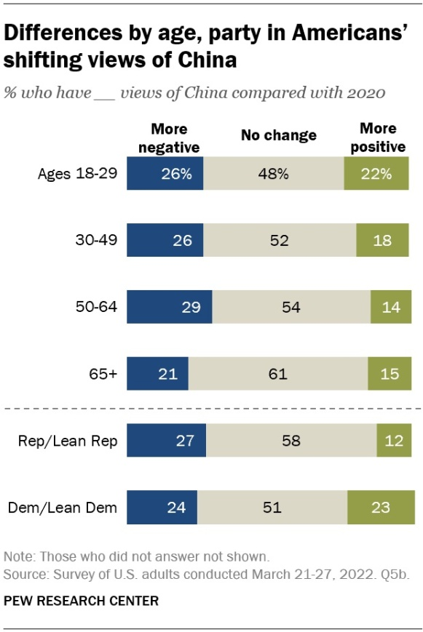
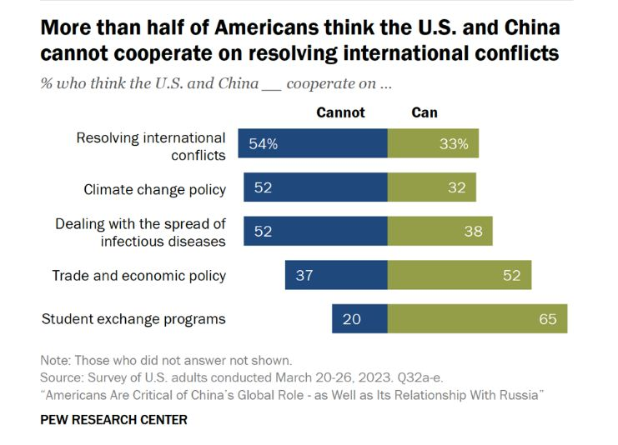
Supporters VS Opponents (party): Survey btw 2020 and 2022
Older adults: negative attitude, the least likely to changed;
Republicans tend to see China’s role in the world in more negative terms than Democrats;
Fortunately, there are two areas where Americans are more open to the possibility of collaboration with Beijing: student exchanges and trade and economic policy.

Slide 12
Supporters VS Opponents
Congress: The U.S.-China Economic and Security Review Commission (supporter)
House: The Select Committee on the Strategic Competition btw US and CCP (?)
The idea that the United States must either bar all Chinese students from studying STEM fields or welcome them into every laboratory is a false choice.
In fact, there is a spectrum of policy options the United States can pursue to guard against the most harmful programs enabling China’s technology transfer ambitions while minimizing the collateral damage done to foreign students and scholars.
Committee Chair Rep. Mike Gallagher;
Matthew Pottinger, Former deputy national security advisor: A Digital Dictatorship (Concerns Over Chinese Surveillance Technology): we need to have a much more rigorous defense and offense.
On the defense side: on the defense side, we don’t want our technologies to be exported to CCP who will silence and intimidate people;
On the offensive side, all we have to do is to connect people, making it easier for Chinese people to see news and info in the free world.

Slide 13
Supporters VS Opponents
The Bureau of Educational and Cultural Affairs (ECA) of the Department of State (supporter)
FBI of the Department of Justice (may not support)
On April 18, Police in New York have arrested two men for allegedly setting up a secret police station for a Chinese provincial police agency to collect information on opponents of the ruling Communist Party.
Chinese Students and Scholars Association is another means of repressing Chinese students. Chinese students need help and support. We should raise concern with FBI.
Campus security is not just for local students, but also for international students.
US Assistant Secretary of State for Education and Cultural Affairs Marie Royce took the opportunity to “clarify misperceptions people have on the US government’s stance on students and scholars from China”
The Chinese Communist Party is actively working to provide an inaccurate picture of the United States to Chinese citizens, including overseas students.
Many institutions are working hard to help Chinese students who want to make friends with American peers. We applaud those schools.

Slide 14


Supporters (interest groups)
The GW Independent Chinese Student Union (GWICSU)
Association of American Universities
American Council on Education
Last year, we put up posters critical of the Winter Olympics in Beijing. In response, the GW CSSA, an organization founded by the PRC and CCP viciously attacked and smeared us. Since then, the GW Democracy Wall has continually been destroyed.
We have resolutely sought to demonstrate that the Party does not speak for us and that we will not be complicit in its abuses.
We presented two letters to the university administration regarding the destruction of our posters. But to this day, they was wholly ignored.
AAU, ACE, and 39 other associations sent a letter requesting a briefing from State Department officials on the implications of Presidential Proclamation 10043.
The letter raises concerns about troubling reports that the proclamation is being applied very broadly and “is causing delays in students’ academic careers and critical projects.”
Latest news: ﻿Prof. Scott Aaronson (quantum computing), “﻿Visas for Chinese students: US shoots itself in the foot”.
Notes:
Photo by Power Point asset

Slide 15
Make Chinese students represent themselves and keep campus safe and prosperous!
Jan-Mar
1
Mobilize more and more Chinese students to stand up against intimidation from CCSA. (prerequisite: report CCSA’s suppression on freedom of speech to FBI; raising awareness of AAU and ACE; remove CCSA from American campus)
2
Independent Chinese student organizations, e.g. GWICSU, write to Senator Tom Cotton, or other members of Congress/House, urging him or her to amend the act and to ensure campus safe for all the students.
Strategy and Discussion
3
AASF can conduct similar research on ﻿the fear among Chinese-origin scientists in the US. Do they feel unwelcome on campus? What reaction should the U.S. administration do for protecting them from being controlled by the CCP? (contact ECA)
4
Align with national interest of the U.S. in the long run:
Expect China to become a responsible player in the international community? Who should the U.S. rely on to change China? Chinese people (young Chinese people). Remember, the protestors in the White Paper Movement are mainly college students around 20 years old.

